Slide 1



Nanofibre Mats for Neurosurgery
Tomasz A. Kowalewski¹,
T. Kowalczyk¹, P. Nakielski¹,
M. Frontczak-Baniewicz², D. A. Gołąbek-Sulejczak², J. Andrychowski²
¹Institute of Fundamental Technological Research,
Polish Academy of Sciences
²Mossakowski Medical Research Centre,
Polish Academy of Sciences
Tomasz Kowalczyk, Tomasz A. Kowalewski
Institute of Fundamental Technological Research, Polish Academy of Sciences, IPPT PAN
tomasz.kowalczyk@ippt.gov.pl
Notes:
1

Slide 2
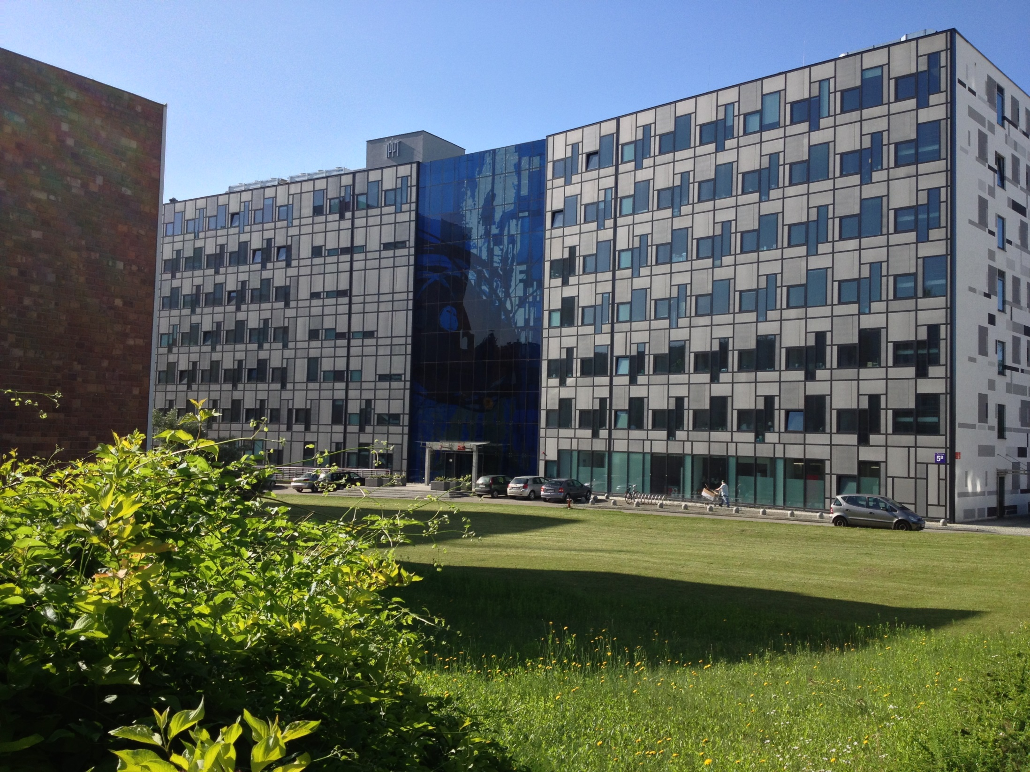
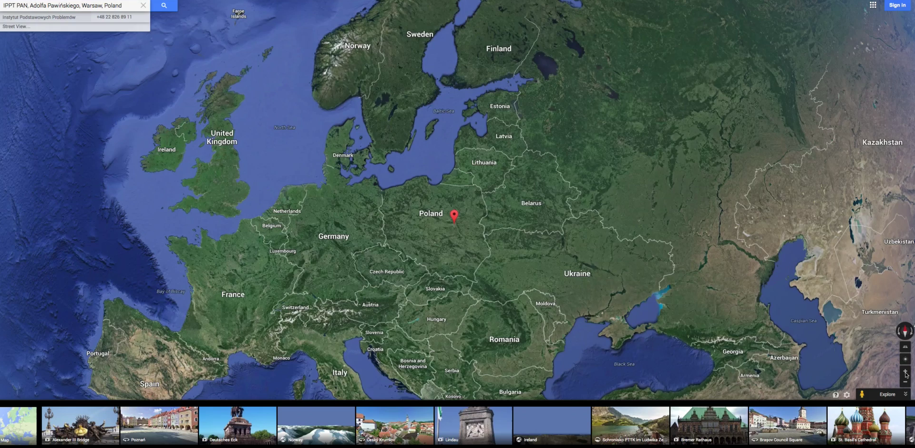

Slide 3
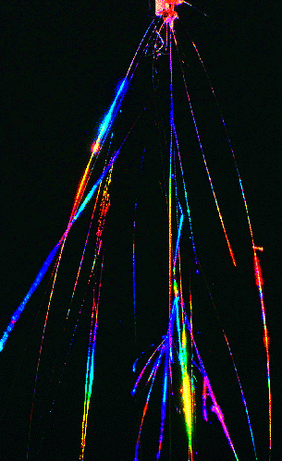
Electrospinning of
NANOFIBRES
  Reduction of characteristic dimension -> nano-biotechnology, tissue engineering, drug delivery
  Bio-active fibres: catalysis of tissue cells growth
  Mechanical properties improvement -> new materials, composite materials, co-fibres of metal-polymer, nano tubes

Slide 4
Electro-spinning
bending instability of electro-spun jet
charges moving along spiralling path
E ~ 10⁵V/m
Bending instability enormously increases path of the jet, allowing to solve problem: how to decrease jet diameter 1000 times or more without increasing distance to tenths of kilometres

Slide 5
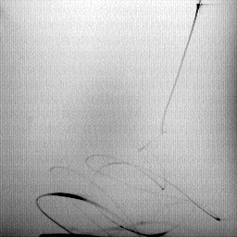
Electrospinning observed at 4500fps
PEO
(poly ethylene oxide)
+ water/ethanol
5 cm

Slide 6
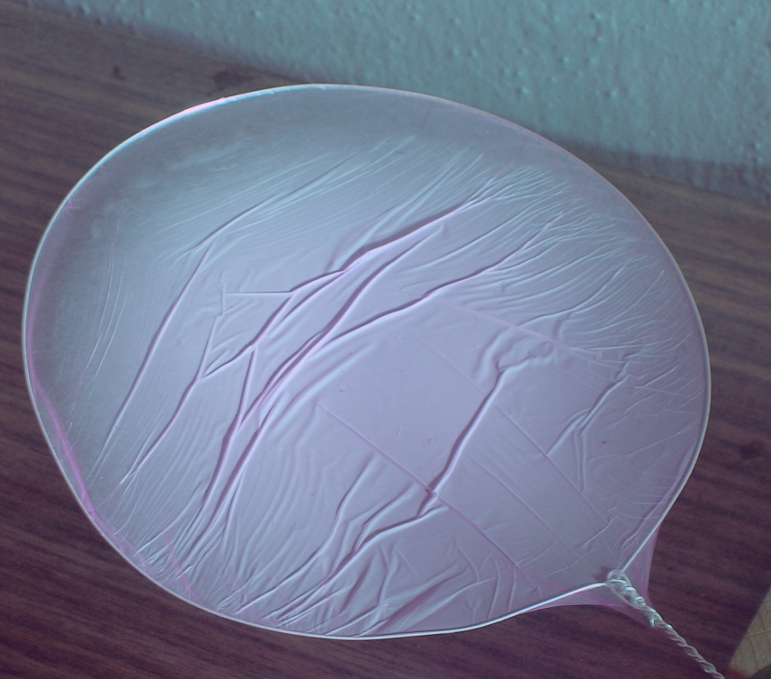
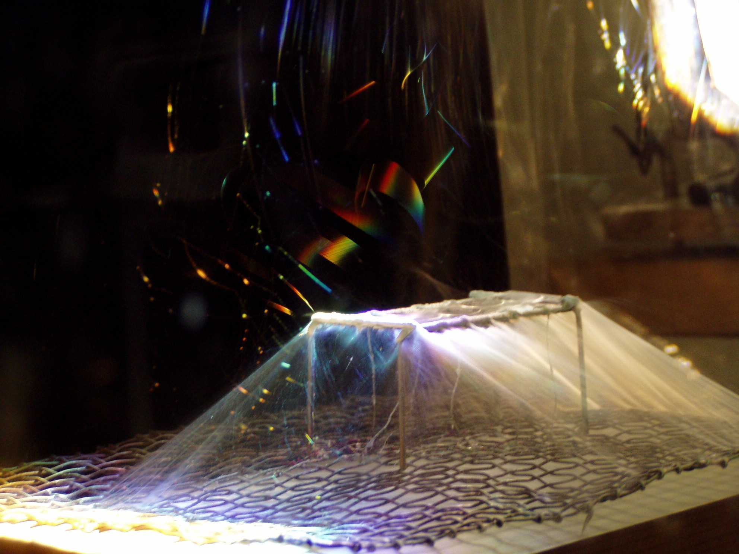
Nanofibres collection

Slide 7
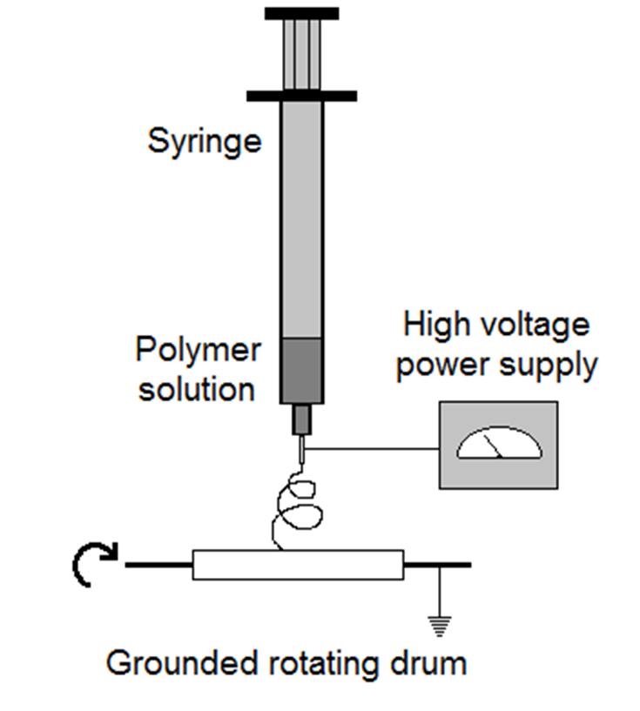
Nanofiber mat production by the electrospinning process
Notes:
7
Tu jest ładny schemat. Jak widać używanie polsko-angielskich rysunków nie sprawia nam problemu.

Slide 8
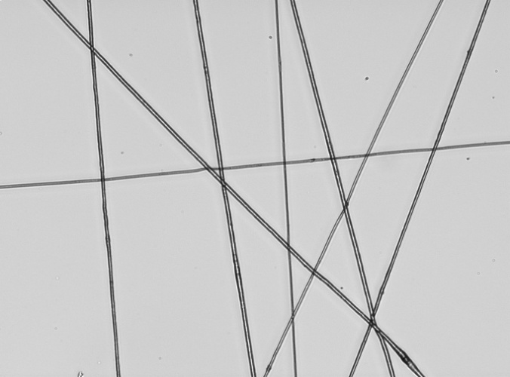
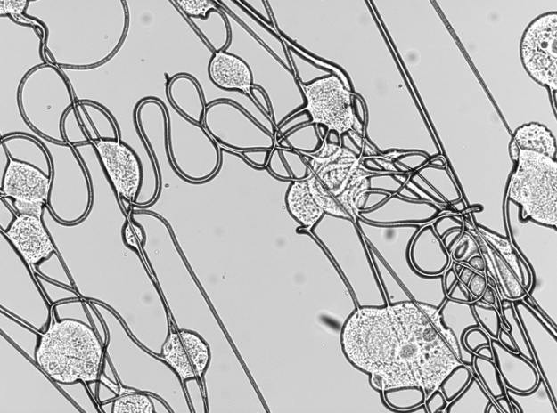
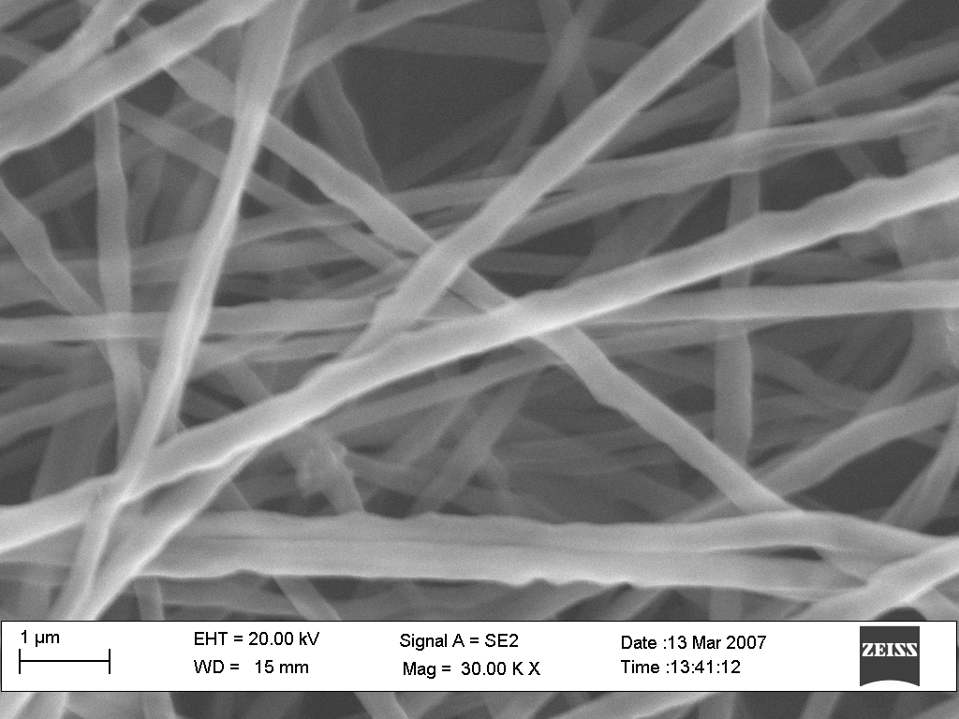
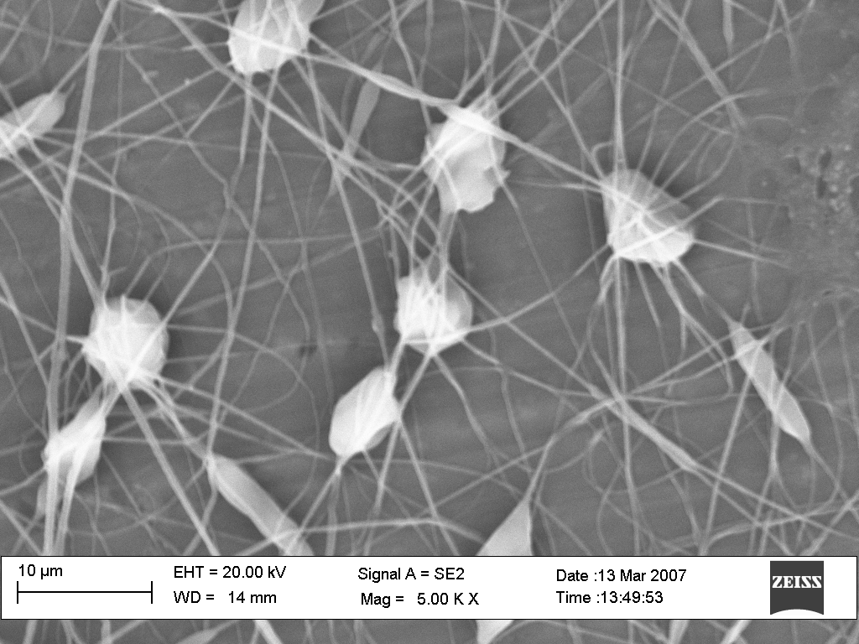
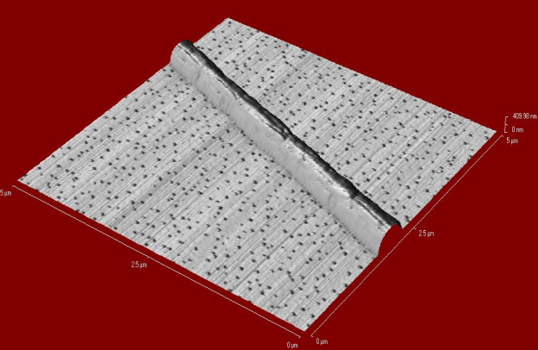
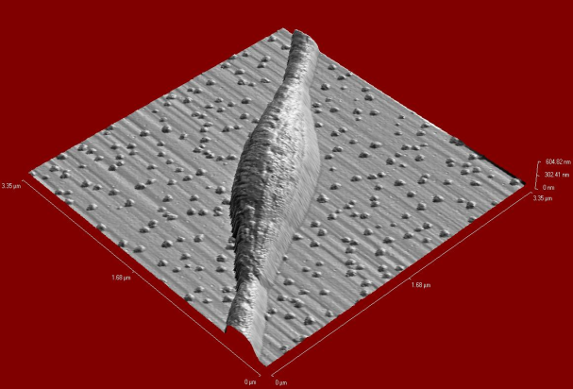
Electrospinning – how to control quality?

Slide 9
Typical electrospinning of bio-materials.
Polymer | Solvent* | Bioapplications **,*** | Comments
DBC (dibutyrylchitine) | ethanol | wound dressing | biocompatible, helps heeling process
TAC (triacetylcellulose) | dichloro-methane | wound dressing
PEO (poly ethylene oxide) | water/ethanol | artery embolization | needs cross-linking, biocompatible
PCL (poly caprolactone) | chloroform | bioresorbable polymer scaffolds for artificial tissues or organs | Biodegradable, biocompatible
P-3HB (poly 3-hydroxybutyrate) | 2,2,2-trifluoroethanol | bioresorbable polymer scaffolds, artificial tissues or organs | biosynthesized, biodegradable, biocompatible
Protein (BSA) | water | FRET sensor, wound dressing
Fluorescent labeled protein | water | disease diagnostic on a cellular level (by FRET technique)
Method opens atractive possibility to compose nanostructure of diverse bio materials

Slide 10
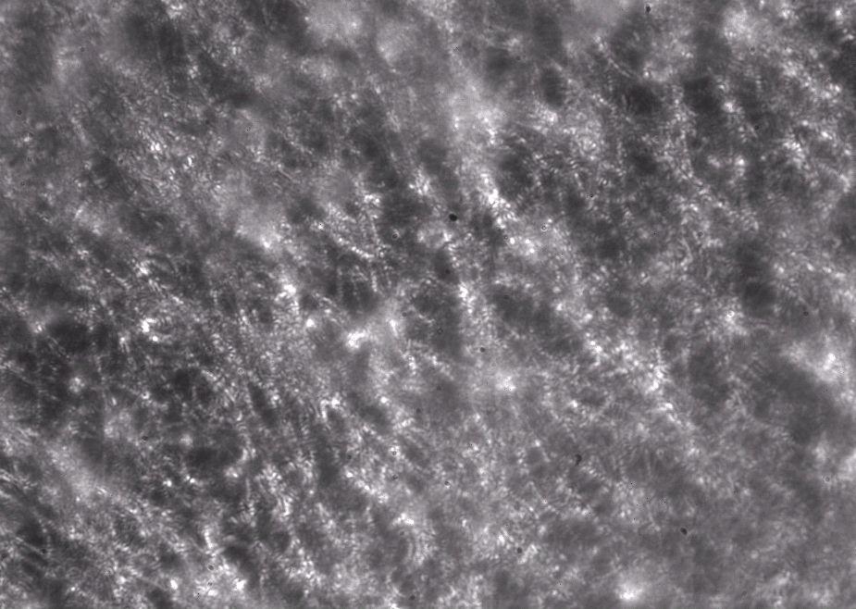
Electrospinning of bio-materials.
Nanofibre matrix PCL/PEO on aluminium foil and SEM image
Scaffolds of poly-caprolactone (PCL), poly-3-hydroxybutyrate (PHB), and copolymer poly-3-hydroxybutyrate-co-hydroxyvalerate (P-3HB). Nanofibres porosity to promote cell adhesion and proliferation. Possible use for modification of Bioglass foams.

Slide 11
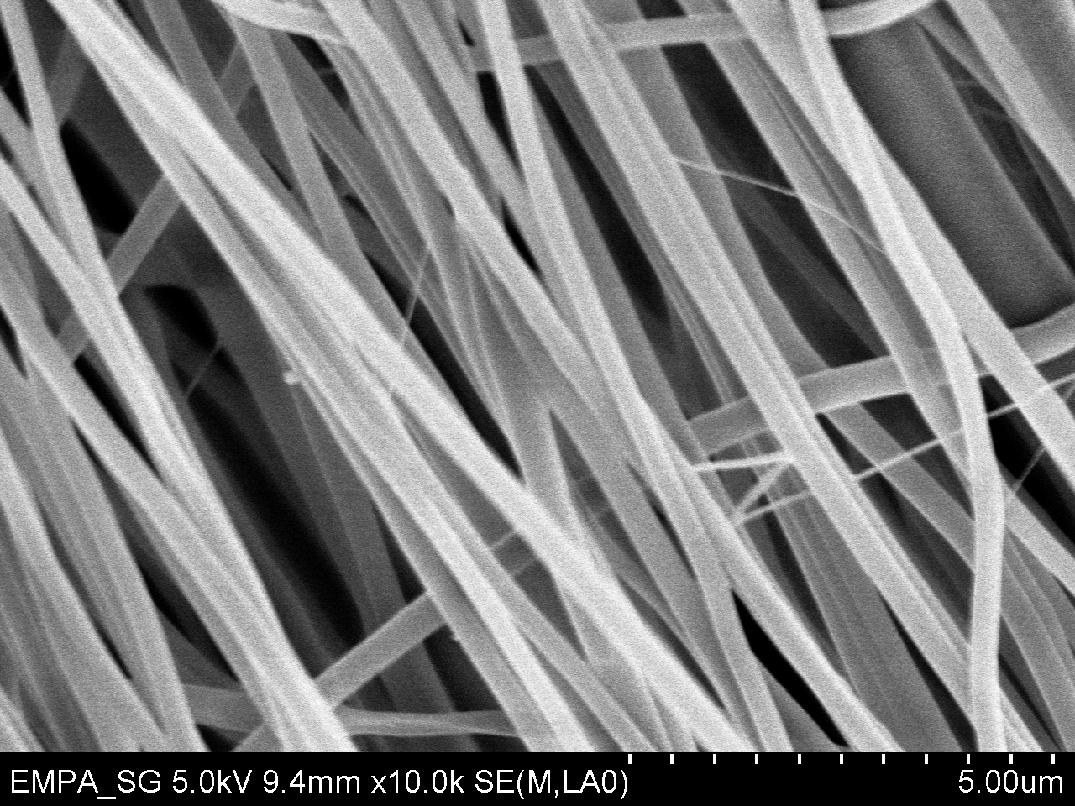
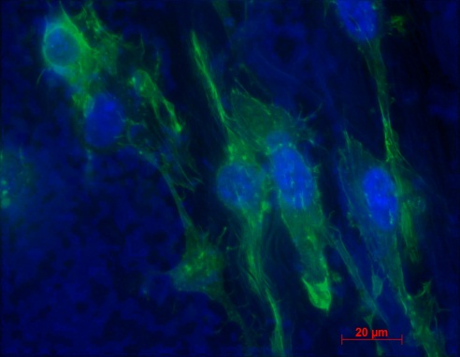
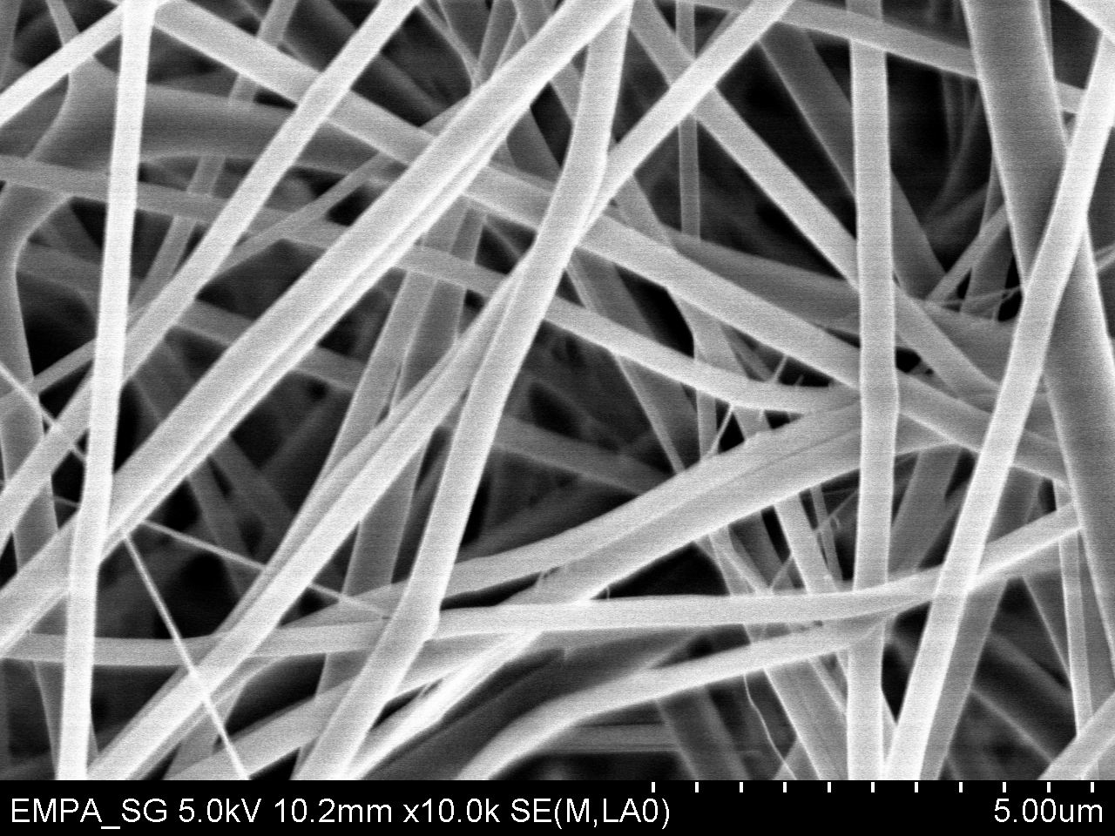
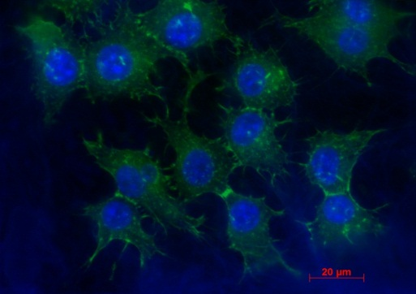
Polycaprolactone/gelatin scaffolds
20μm
20μm
SEM and fluorescent microscope images of 3T3 fibroblasts on PCL/gelatin scaffolds after 4 days in vitro conditions.
Effect of fibers orientation

Slide 12
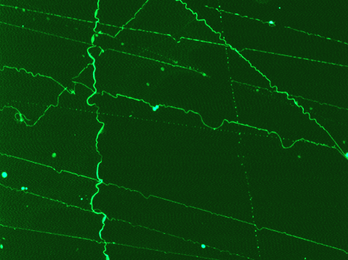
Electrospinning of bio-materials.
Fluorescence tagging
Nanofibre made of Bovine Serum Albumin (85%) and poly(ethylene oxide) (15%), water solution. Labelled with fluoresceine isothiocyanate (FITC).
Demonstrated as pH sensor

Slide 13
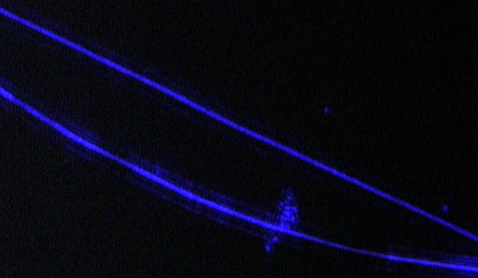
Electrospinning for quantum - wires.
Fluorescence microscopy image of ZnO quantum wires organized in an electrospun fibre. Temperature and pH sensor

Slide 14
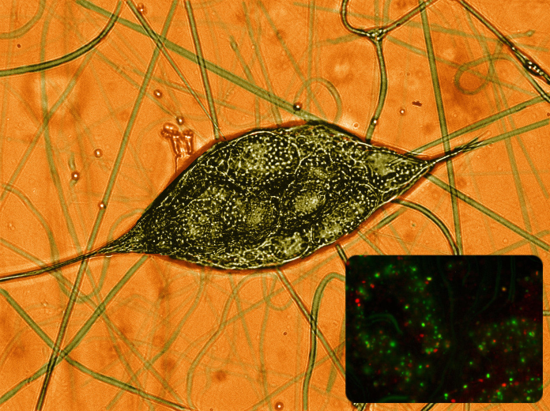
Electrospinning living cells
Encapsulated yeast cells

Slide 15
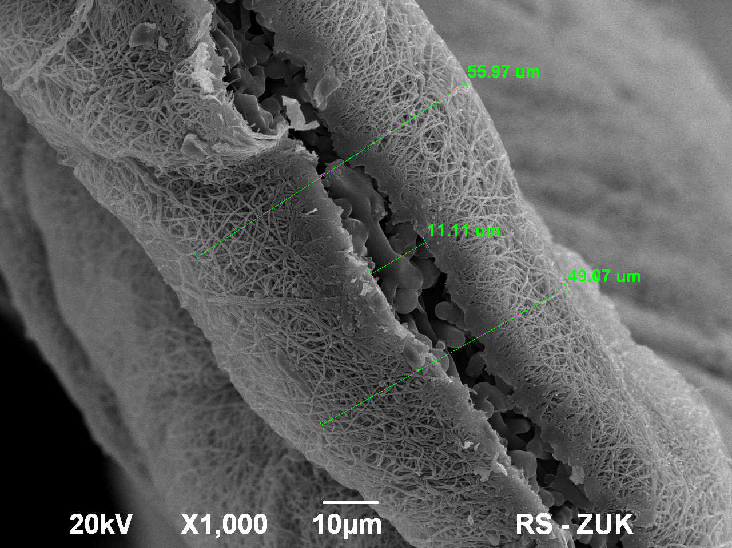
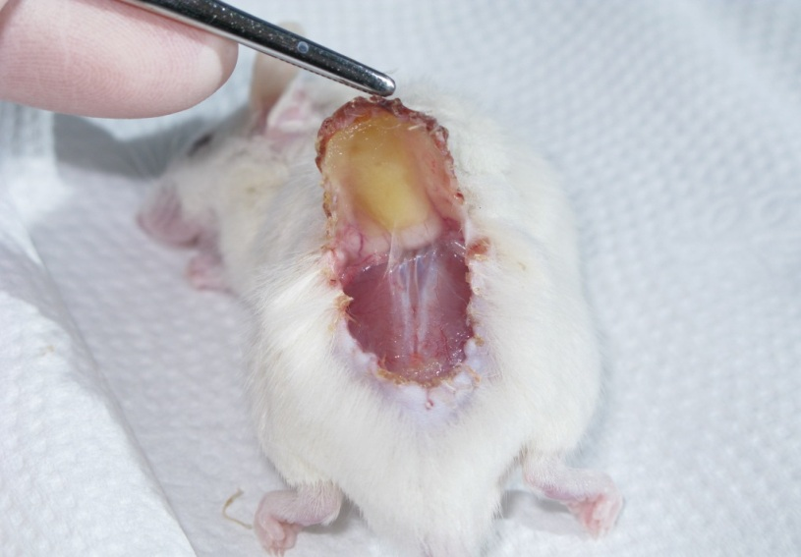
Electrospun membranes used as wound dressing material
B.Noszczyk
SEM micrograph and application in vivo of nanofibrous membrane made of Human Serum Albumin mat

Slide 16
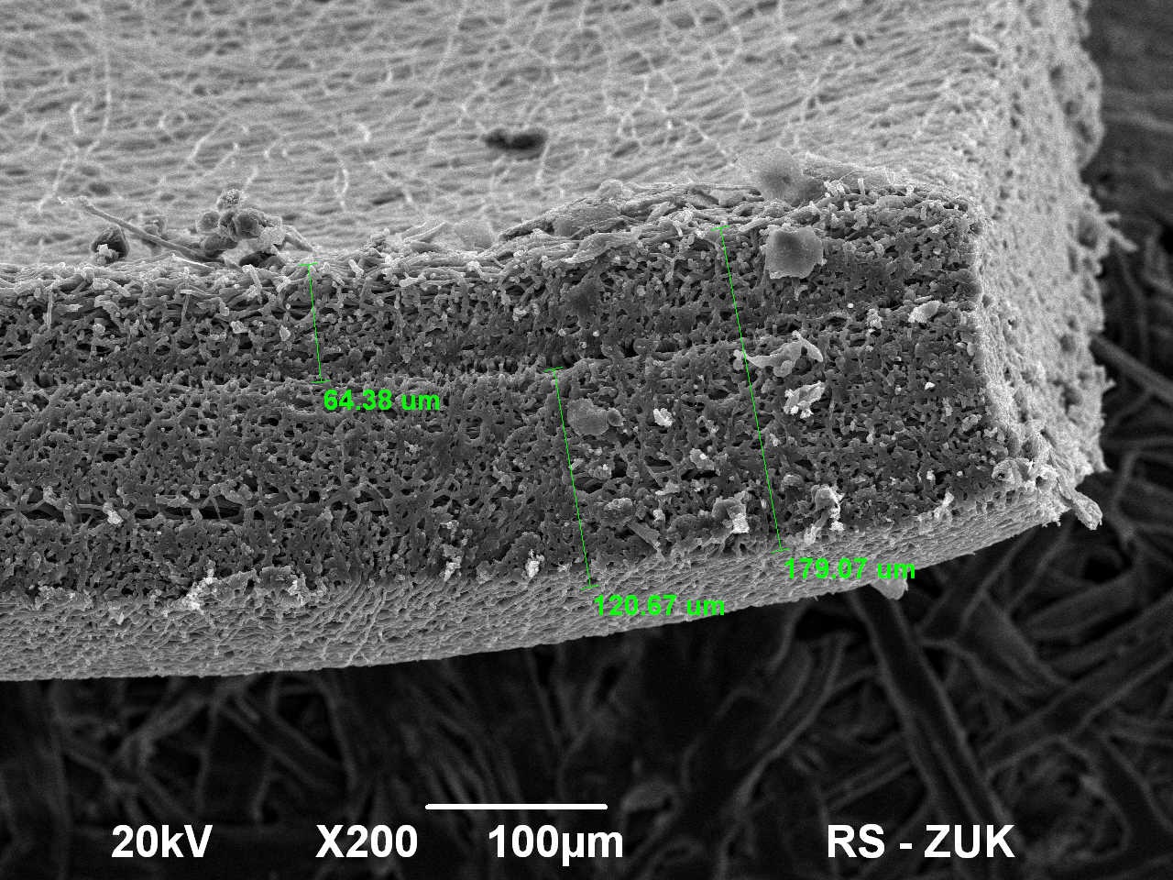
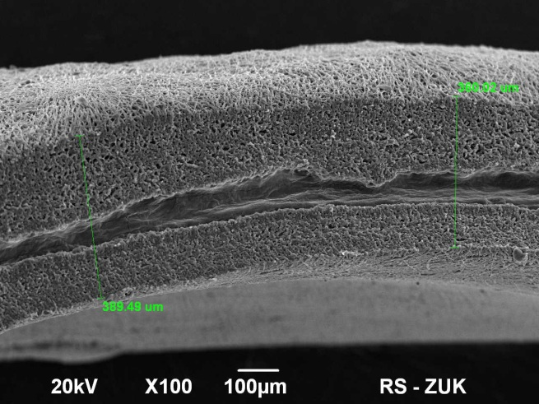
Electrospun membranes used in urology
PLCL nanofibrous mat
PLCL nanofibrous mat surrounding amniotic membrane
SEM micrographs of nanofibrous membranes made of PLCL, used for in vivo experiments on rats, aimed for urinary bladder wall reconstruction

Slide 17
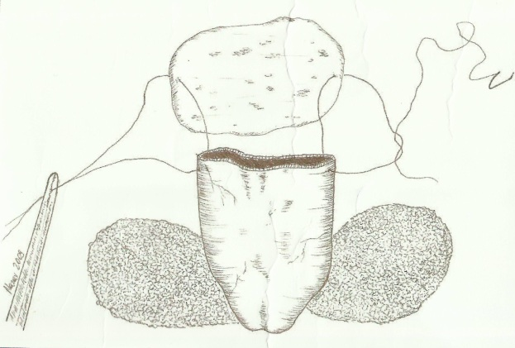
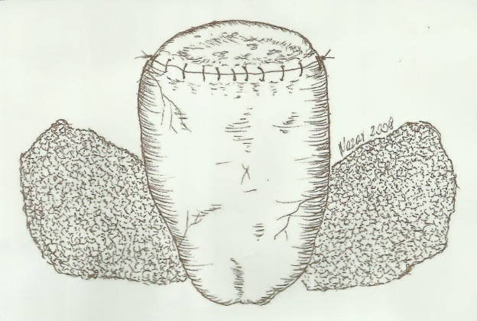
Biocomposite made from amnotic membrane and PLCL, seeded with stem cells
Amnotic membrane
PLCL
10 rats underwent hemi - cystectomy. The gap ( 0,7 cm² ⁾ in the urinary bladder doom was augmented using in vitro constructed graft.
J. Adamowicz
J. Adamowicz
Applied multi layer graft composition is supposed regenerate urinary bladder wall that stand requirement for normal bladder tension development, contraction, elasticity and compliance.

Slide 18

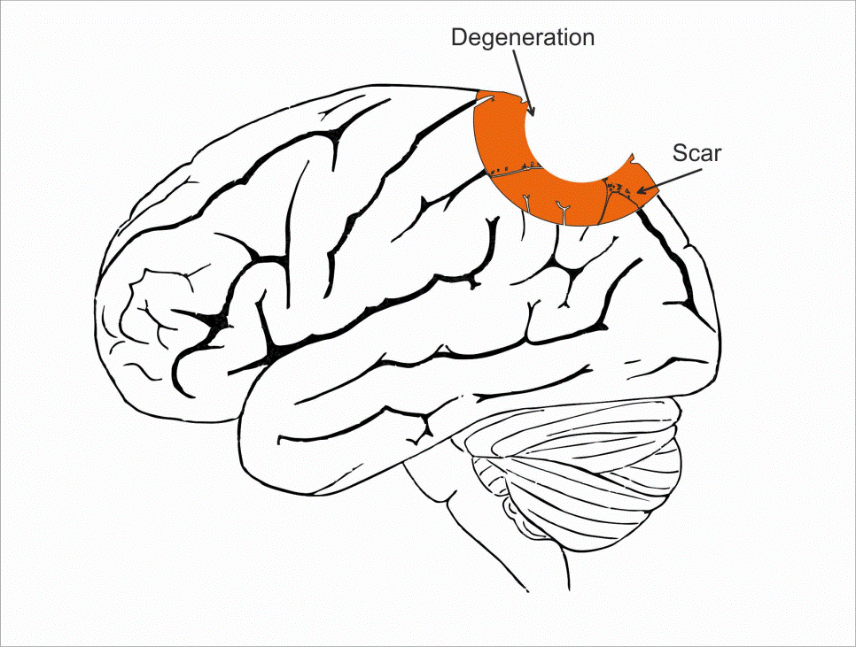
Nanofibrous mats for neuroprotection
The lack of effective neuroprotective products for postoperative treatment of spinal cord or brain injures that lead to scar tissue formation and in worst case to death of the patient.
Notes:
Historia systemów podawania leków, różne metody, ale w przypadku neurochirurgicznych to nie ma. Żadne kapsułki, bo się bierze co chwila. Ze względu na strukturę budowy tkanki mózgowej i dostęp do tego miejsca nie możliwe jest podanie leków takich jak kapsułki. Niewiele zrobiono w dziedzinie opatrunków, oddzielające gojące, Można użyć leków lipofilowych
Elektroprzędzone opatrunki są biokompatybilne, biodegradowalne, łatwe oraz stosunkowo tanie w produkcji.
Uwalniane w sposób kontrolowany leki mogą zatrzymać degenerację oraz śmierć komórek nerwowych.

Slide 19
Nanofibrous mat used for neuroprotection

Slide 20
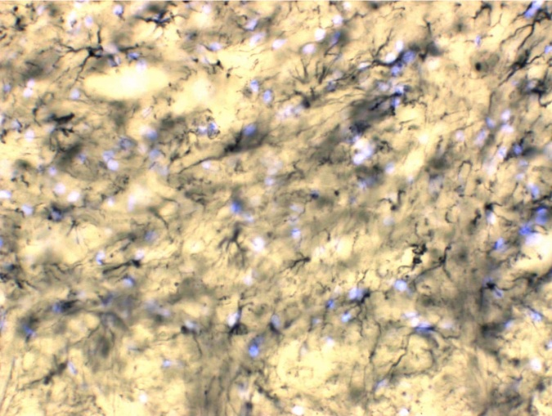
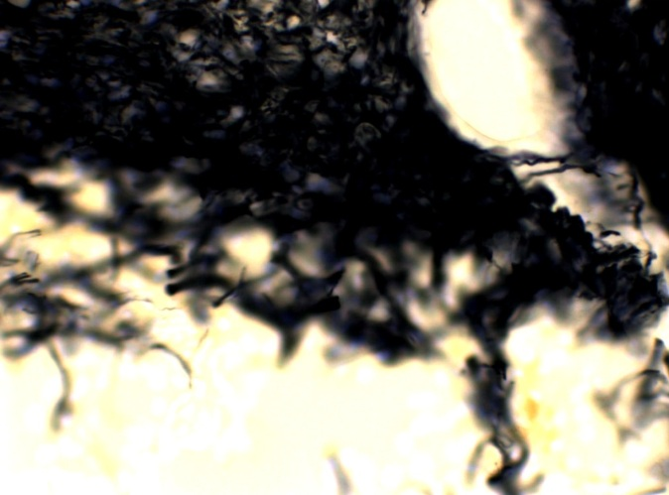
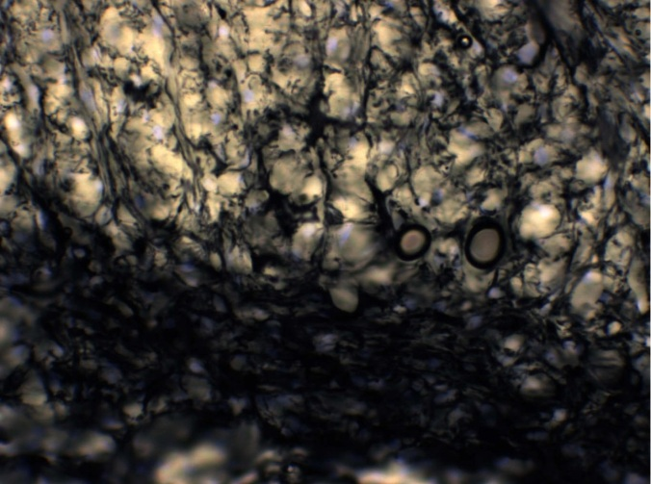
Electrospun mat used for prevention of an excessive cicatrization after neurosurgery – animal model
Intact spinal cord
Injured untreated spinal cord
Injured treated spinal cord
Ultrastructural features of spinal cord protected by neuoprotective electrospun wound dressing. Glial fibrillary acidic protein (GFAP) stain. Massive neurodegeneration and shrinkage of cells is partially avoided by nanomaterial application

Slide 21
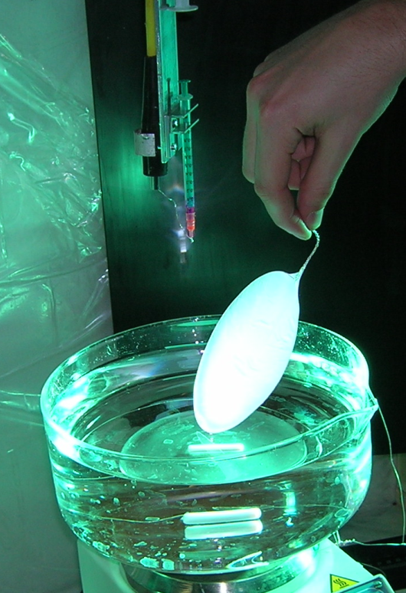
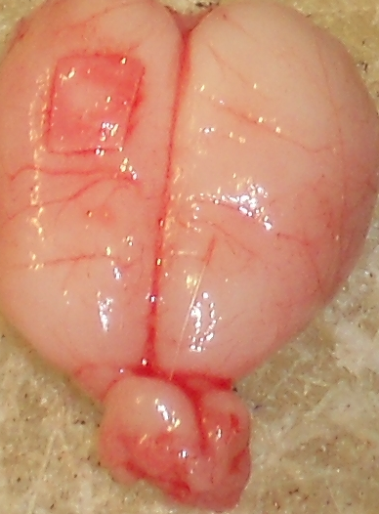
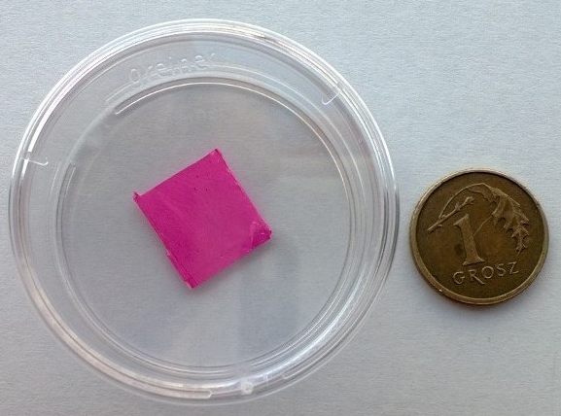
Nanofibrous mat for brain injury
Dressing on wounded brain tissue
Nanofibrous mat

Slide 22
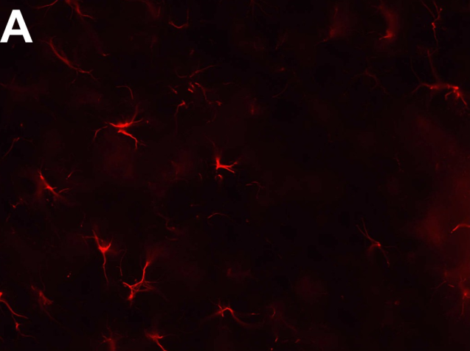
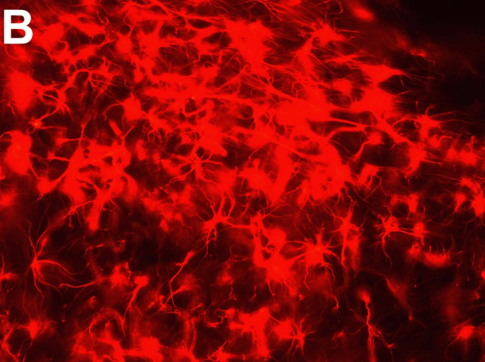
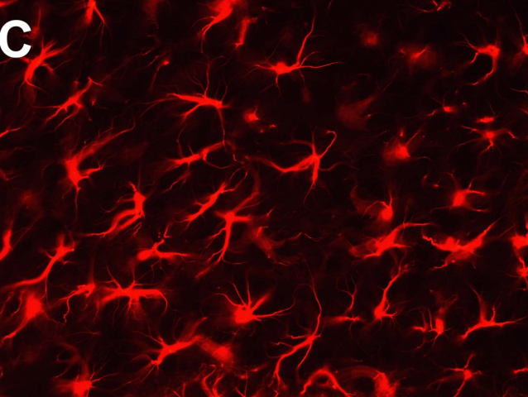
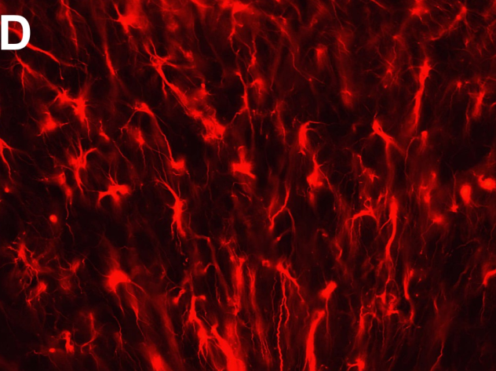
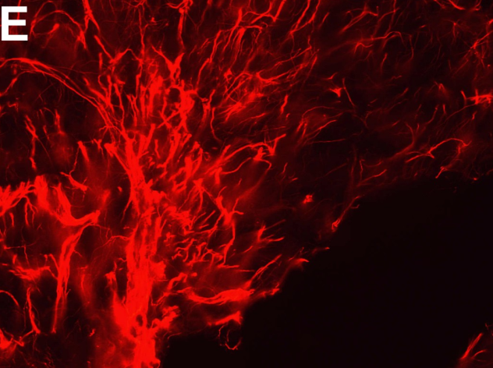
Electrospun wound dressing used for neuroprotection in TBI– animal model
M. Frontczak-Baniewicz, D. Sulejczak, J. Andrychowski
Intact spinal cord
Immunohistochemical features of brain sections from control group(A), unprotected brain injury(B) and protected by neuoprotective electrospun wound dressing(C-4, D-14, and E-30 days post operation. Glial fibrillary acidic protein (GFAP) stain. Hypertophied cells of untreatet glial scar (B), compared to less reactive and more ordered scar treated with nanomaterial application(C-E)

Slide 23
Drugs used in nanofibers
Vitamin E – antioxidant
NGF – nerve growth factor
BDNF – brain derived neurotrophic factor
      specific for brain tissue

Slide 24
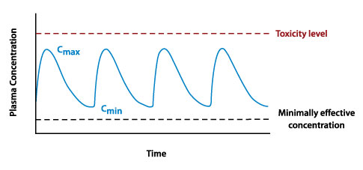
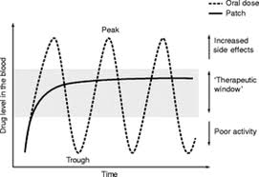
Continuous Drug Delivery System -advantage over multiple dosage
www.saldax.com
www.neurology.org
Concentration profile of a drug administered by multiple injection or oral dosage
Using electrospun nanofibrous mats for continous DDS

Slide 25
Electrospun nanofibers based DDS
Polyesters used for biodegradable polymer matrix
Polyester | Metabolyte
PGA, poly(glycolic acid) | glycolic acid
PLA, poly(lactic acid), polylactide | lactic acid
PHB, poly(3-hydroxybutyric acid) | 3-hydroxybutyric acid
PCL, poly(caprolactone) | ω-hydroxyhexanoic acid
copolymers
PLGA, poly(lactic-co-glycolic acid) | lactic acid, glycolic acid
PLCL, poly(L-lactide-co-caprolactone) | lactic acid, ω-hydroxyhexanoic acid

Slide 26
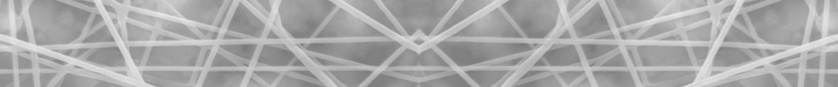
Drug Systems
Target | Analog
Lipophilic - solid fiber, core-shell
α-tocopherol 430Da, r_{H} = 0,92nm | Rhodamine B 479Da, r_{H} = 0,9nm
Hydrophilic – core-shell, emulsion electrospinning
Sodium glutamate 169Da, r_{H} = 0,56nm | Methylene Blue 320Da, r_{H} = 0,26nm
Neuron Growth Factor 13,4kDa, r_{H} = 4,9nm | Bovine Serum Albumin-FITC 66kDa, r_{H} = 4,65nm
Brain Derived Neurotrophic Factor 13,6kDa, r_{H} = 2,6nm
 | Gadovist* MRI contrast agent 605Da, r_{H} = 0,8nm

Slide 27
External Fluid Systems
Target | Analog
Cerebrospinal Fluid Volume exchange ≈ 3 times/day | PBS solution At sink conditions (infinite medium)
Brain tissue D_{tracer} = 1,3 · 10⁻¹¹ m²/s k_{elim} = 0,014 1/s | PVA – Borax hydrogel D_{rodB} = 6,3 · 10⁻¹¹ m²/s

Slide 28
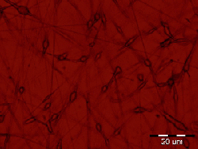
How to obtain optimal release profile?
Selecting desired drug-polymer configuration
Selecting optimal material structure (porosity, multilayer)
Verifying release profiles for „analog system” and targeted one
Modeling, verifying and validating models
Analog system
Targeted system
22 days
Fluorescence microscopy of encapsulated Rhodamine B
Release profile of α-tocopherol from PLCL fibers

Slide 29
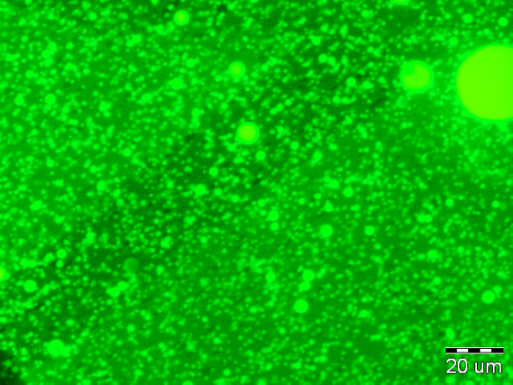
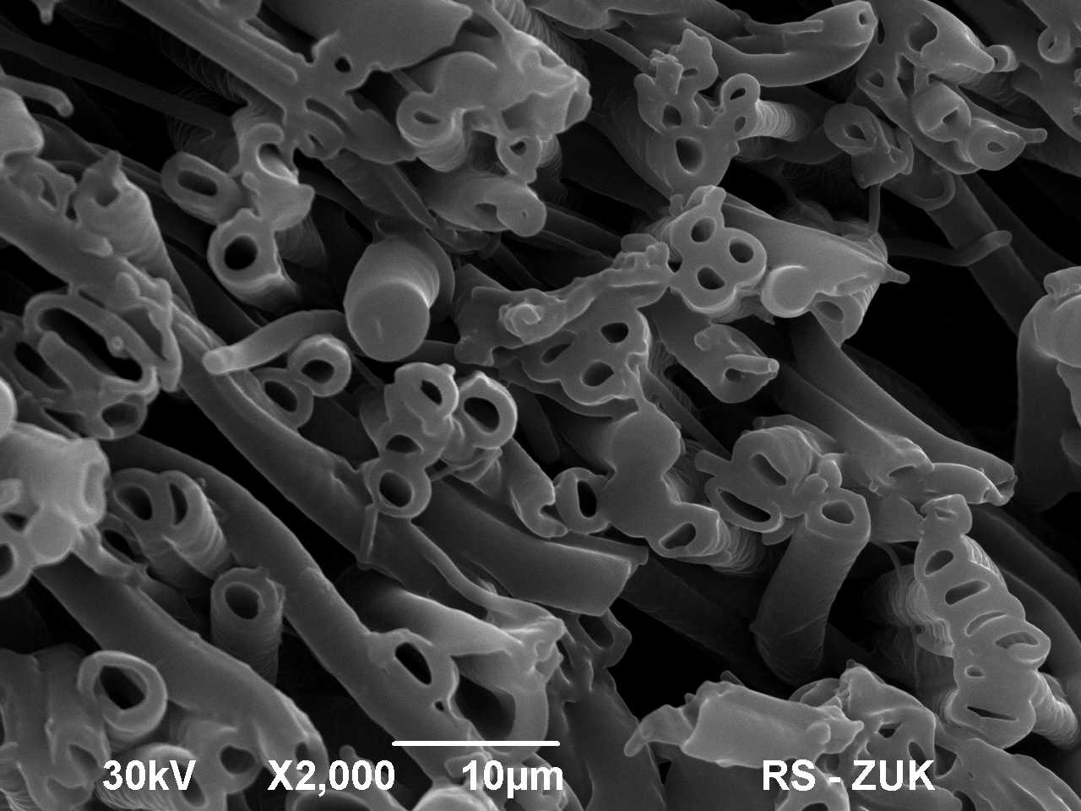
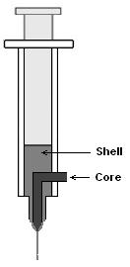
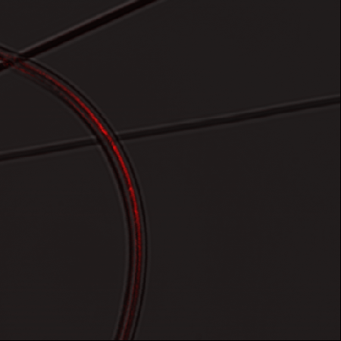
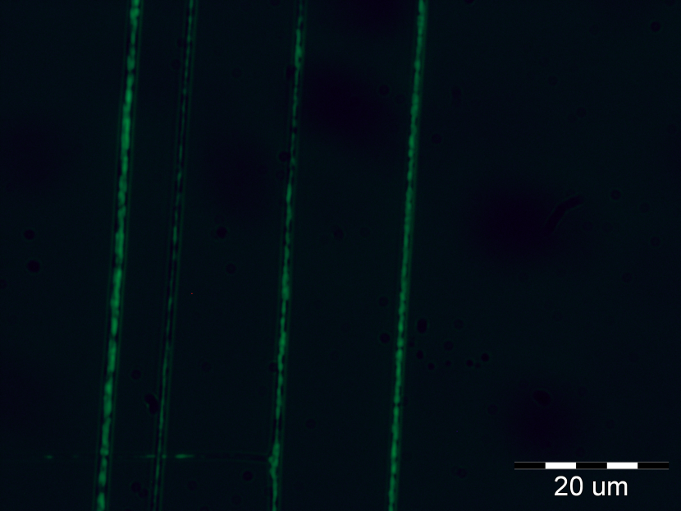
Drug encapsulation methods
Solid fibers (lipophilic drugs)
Emulsions (hydrophilic drugs)
Core-shell (hydrophilic, lipophilic )
W/O emulsion from fluoresceine in PLCL solution
Rhodamine B loaded core in PLCL shell
Confocal microscopy
Nanofibers made by emulsion electrospinning

Slide 30
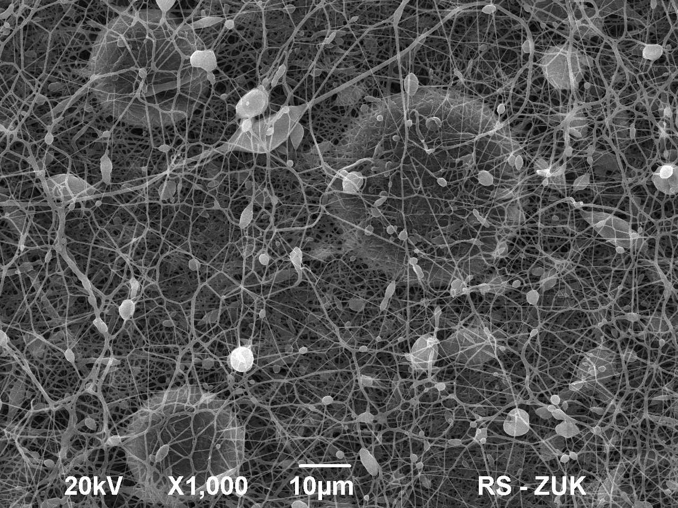
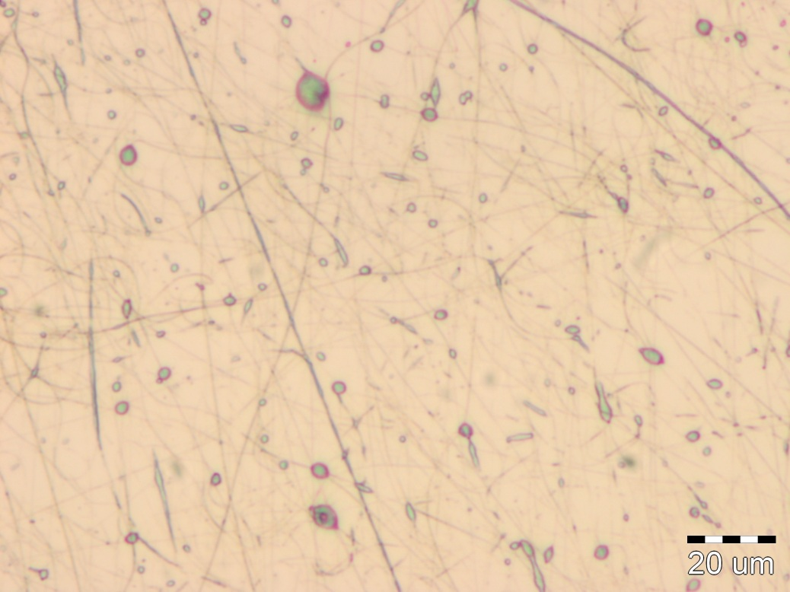
Drug Delivery Systems
Emulsion electrospun membranes
- Applied polymers: PCL, PLCL, PLLA
- Fibers with „beads” containing drug or model dye

Slide 31


Macroscopic encapsulation
Sandwich membrane multilayer
using aligned nanofibres
Sandwich membrane– middle layer loaded with Rhodamine B
Aligned PLCL nanofibers

Slide 32
Analysing and Modelling
1. Release of the analog drug from nanofibrous mats to hydrogel
2. Diffusion of the analog drug – FRAP optical analysys of the diffusion process in the hydrogel
3. Release of the analog drug from nanofibrous mats to buffer simulating cerebrospinal fluid (spectral fluorymetry)
4. ELISA – enzyme-linked immunosorbent assay – concentration analysis of target drug in buffer simulating cerebrospinal fluid

Slide 33


Experiments with analog drug systems
Rhodamine release from nanofibrous mats
Samples dimension:
Radius = 2,5 mm
Thickness = 150 μm
Cuvette with material on the top of the PVA hydrogel

Slide 34



Experiments with drug analog
quantitative study and diffusion coefficient determination FRAP
Optical measurement at the experimental setup
Microscopic measurement FRAP analysis
Diffusion coefficient of Rhodamine B
in PVA hydrogel D_{eff} = 6,3 ±1,1 10⁻¹¹ m²/s
Image from the experiment presenting drug transport from the material

Slide 35

Desorption – diffusion model in porous material

Slide 36
Desorption – diffusion model in porous material
C_{A} – drug concentration at the nanofiber surface [kg/ kg of the material]
C^{max}_{A} – maximal drug concentration at the nanofiber surface [kg/ kg materiału]
C_{B} – drug concentration in the pores of the material[kg/m³]
– porosity of the material[-]
D_{B} – diffusion coefficient in the fluid [m²/s]
ρ_{p}– polymer specific density[kg/m³]
k_{a}, k_{d} – adsorption and desorption constant

Slide 37


Rhodamine B release results in the hydrogel random nanofibers
Diffusion coefficient D = 6,3 ·10⁻¹¹ m²/s
Desorption conts. k_{d} = 3,4 ·10⁻⁴ 1/s
Porosity ε = 0,69

Slide 38


Rhodamine B release results in the hydrogel core-shell nanofibers
Diffusion coefficient D= 6,3 ·10⁻¹¹ m²/s
Desorption conts. k_{d} = 7,5 ·10⁻⁵ 1/s
Porosity ε = 0,61

Slide 39


Rhodamine B release results in the hydrogel multilayer
Diffusion coefficient D = 6,3 ·10⁻¹¹ m²/s
Desorption conts. k_{d} =4 ·10⁻⁵ 1/s
Porosity ε = 0,64

Slide 40


Rhodamine B release results in the hydrogel aligned nanofibers
Diffusion coefficient D = 6,3 ·10⁻¹¹ m²/s
Desorption conts. k_{d} = 4,1 ·10⁻³ 1/s
Porosity ε = 0,12

Slide 41



3D numerical simulations of drug release

Slide 42




Numerical results for materials with different porosity
ε = 0,4
ε = 0,78

Slide 43






Numerical results for materials with different fibers orientation

Slide 44
Experimental results of Rhodamine B release in PBS buffer
Cumulative release < 100% !

Slide 45
Experimental results of a-tocopherol release
Uwalnianie
statyczne
dynamiczne

Slide 46
Experimental results of drugs release :
NGF and BDNF
Comparison of protein release for different amounts of the aqueous phase
Comparison of NGF release for different type of electrospinning

Slide 47
Conclusions
Experimental system is suitable for the evaluation of produced Drug Delivery Systems
Aligned nanofibers had the bigest burst release and slow release
This nanofibers are used to release sodium glutamate to irritate motor neurons to produce rat model for the Amyotrophic Lateral Sclerosis.
Sandwich membrane can decrease initial burst of drug
Core-shell nanofibers prolong drug release
 | Hydrogel |  | PBS
Material | k_{des} [1/s] | ε | k_{des} [g/cm²]
Irregular nanofibers | 3,4 · 10⁻⁴ | 0,69 | 1,7 · 10⁻⁹
Aligned nanofibers | 4,1 · 10⁻³ | 0,12 | 5,9 · 10⁻⁹
Sandwich mat | 0,4 · 10⁻⁴ | 0,45 | 3 · 10⁻¹⁰
Core-shell | 7,5 · 10⁻⁵ | 0,61 | 1,5 · 10⁻⁹

Slide 48
Possible commercialization
The potential of the market:
urology, oncology, general surgery and cardiology
Positive results:
single or multi-drug release in time of weeks
controlled drug release
no signs of inmflammation after neurosurgery
no signs of cell death
material prevents scar formation
Patents: P.390140 (pending), P.395894 (pending), P.404667 (pending)
48

Slide 49
Acknowledgments.
- P. Sajkiewicz, T. Chmielewski, A. Molenda, IPPT PAN
-J. Rafałowska, IMDiK PAN
- T. Drewa, T. Kloskowski, J. Adamowicz, UMK Collegium Medicum
- T. Ciach, WUT, IChiP
- R. Stachowiak, WU, Biology Dept.
- B. Noszczyk, MCP
This research is supported by Ministry of Science and Higher Education, NCBiR grant no. R13008110. Paweł Nakielski has been supported with a scholarship from the European Social Fund, Human Capital Operational Program.
Notes:
49
A tutaj jest slajd „za udział wzięli”, można wpisać instytucje współpracujące

